Slide 1
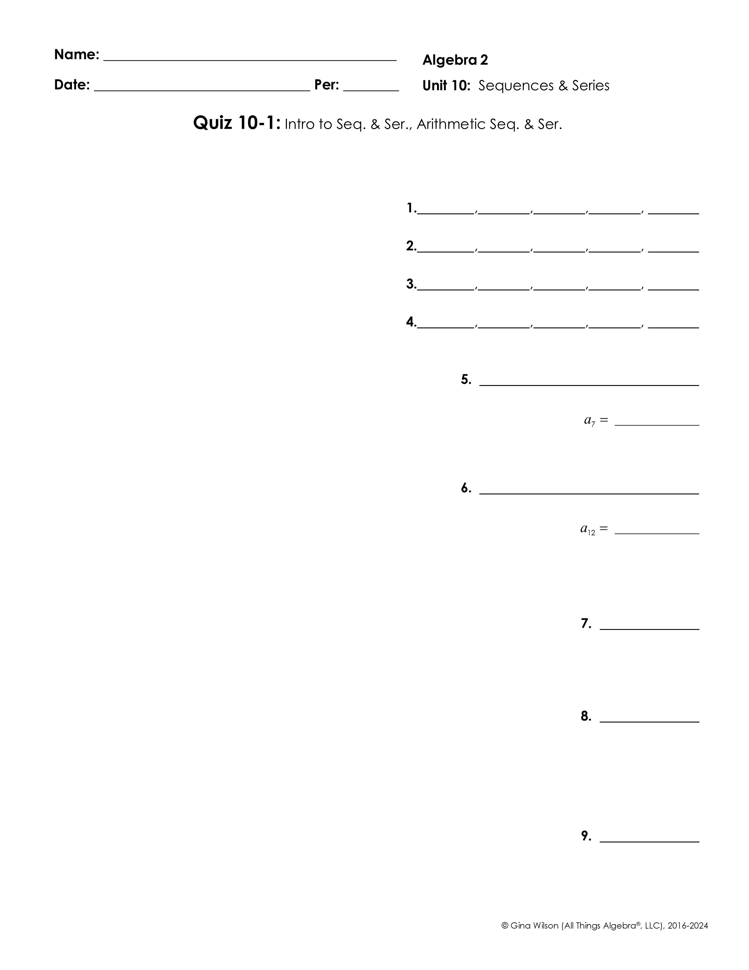
Part I: Intro to Sequences & Series
Give the first five terms of each sequence.
1.
(for n ≥ 2 )
2.
(for n ≥ 3)
3.
4.
5. Write a recursive formula to represent the sequence, then find a₇.
6. Write an explicit formula to represent the sequence, then find a₁₂.
Find the partial sum for each sequence.
7.
8.
Expand and evaluate the series.
9.

Slide 2
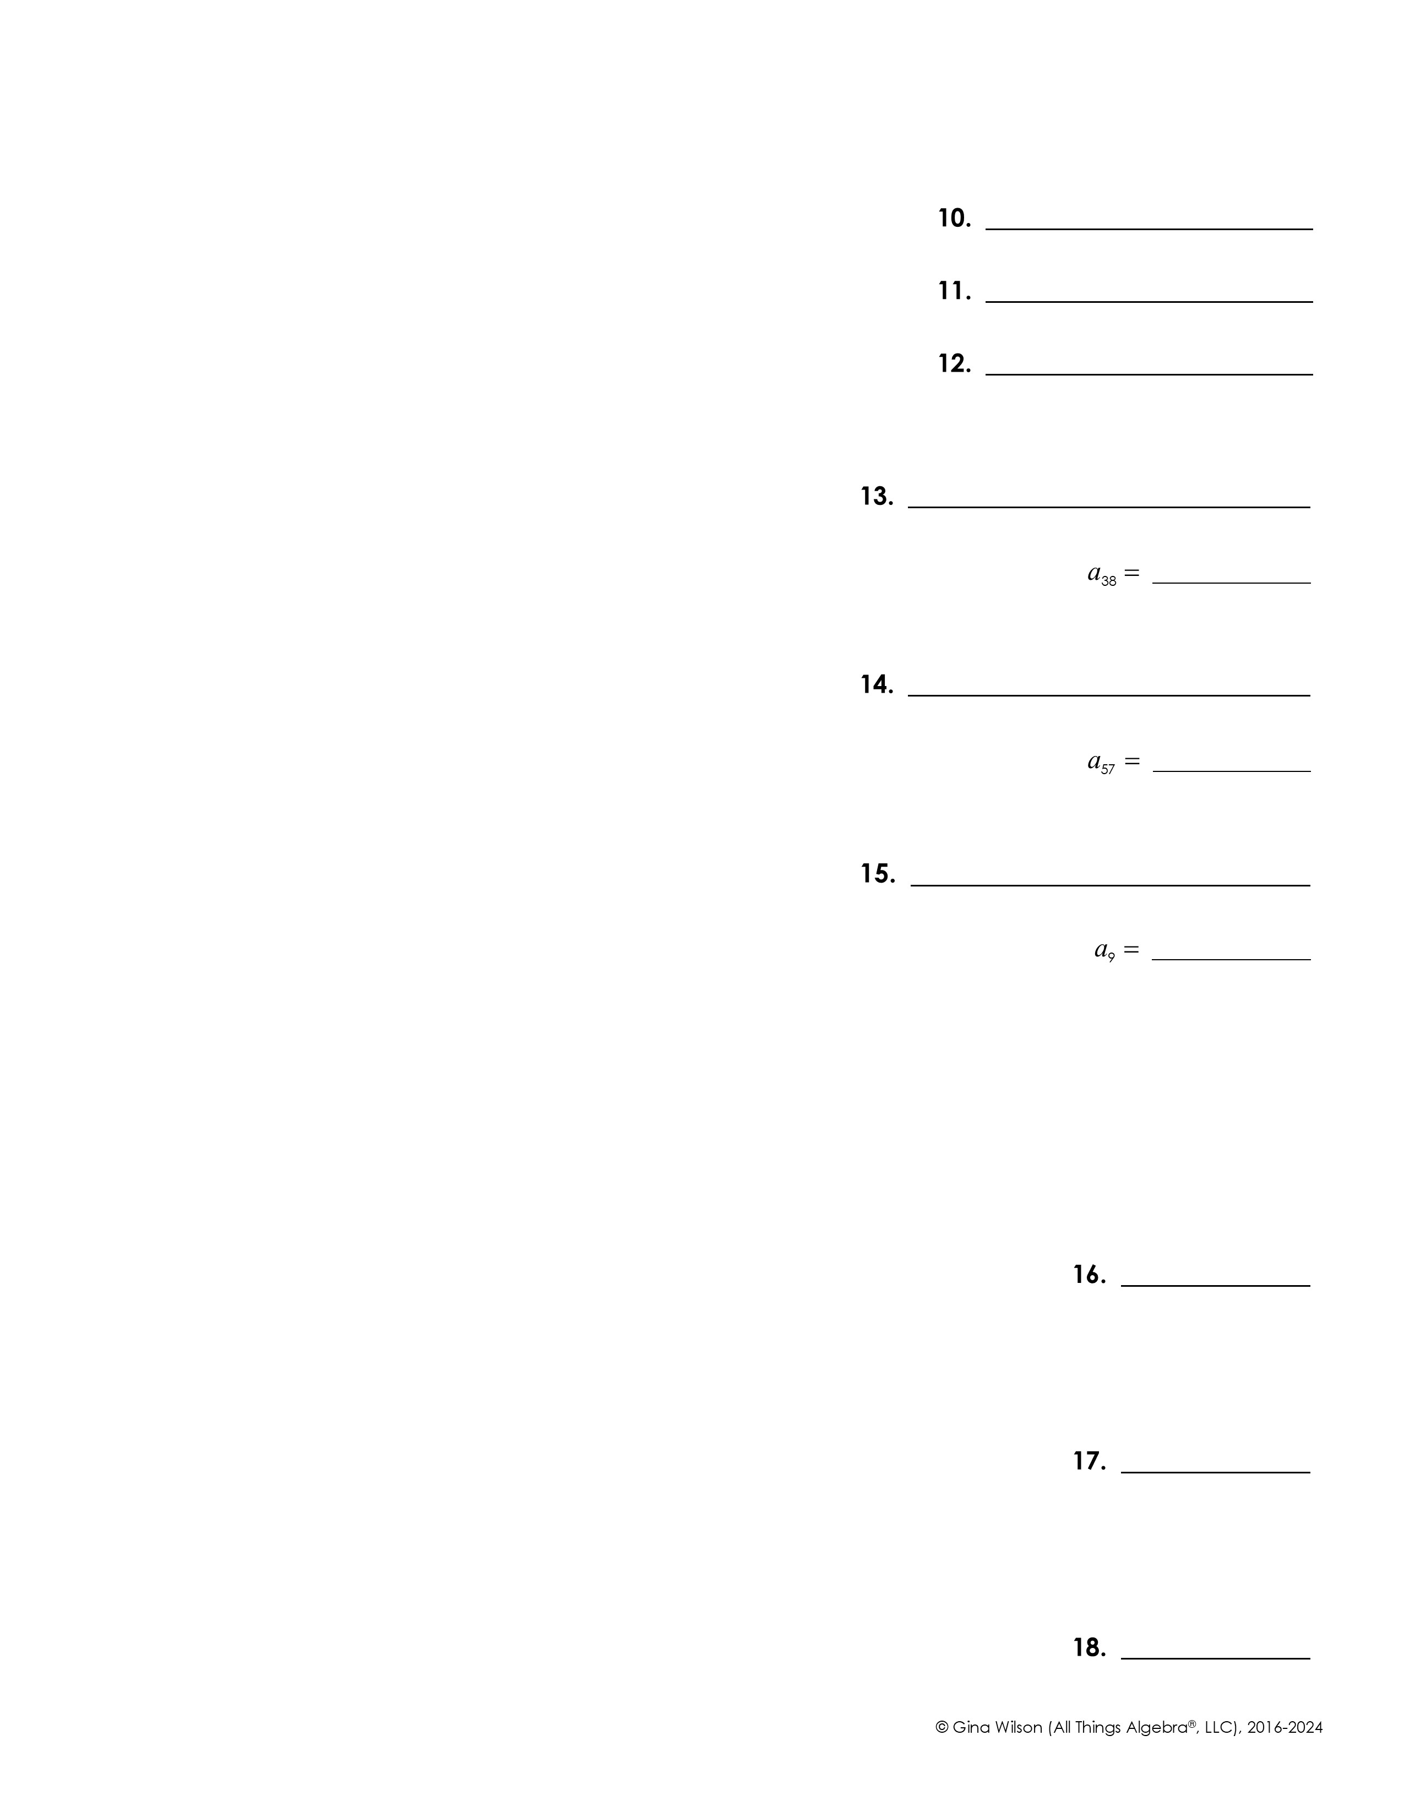
Part II: Arithmetic Sequences & Series
Determine whether the sequence is arithmetic. If yes, identify the common difference.
10.
11.
12.
Write a rule for each sequence, then find the indicated term.
13.
14.
15. The terms below are part of an arithmetic sequence. Write the rule, then find a₉.
and
Find the indicated sum for each arithmetic series.
16.
17.
18.

